Slide 1
CGPA AND TGPA CALCULATOR
Presented BY:-
VINAY KAMAL
RAJA KARTHEEK
TANMAY VASTAV

Slide 2
INTRODUCTION:-
CGPA (Cumulative Grade Point Average) and TGPA (Term Grade Point Average) calculators are tools that help students to calculate their average academic performance.
CGPA is a measure of a student's overall academic performance throughout their academic career, calculated by averaging the grade points earned in all the courses they have taken. TGPA, on the other hand, measures a student's academic performance in a particular term or semester, calculated by averaging the grade points earned in the courses taken during that term or semester.
Both CGPA and TGPA are calculated based on the grading system used by the institution or university, which assigns grade points to different letter grades. The grade points are then multiplied by the credit hours of each course to determine the total grade points earned.
CGPA and TGPA calculators make it easy for students to calculate their average academic performance without the need for manual calculations, helping them to track their progress and make informed decisions about their academic future.

Slide 3
IMPORTANCE OF CGPA CALCULATOR
CGPA (Cumulative Grade Point Average) calculator is an important tool for students, as it allows them to track their academic progress and measure their overall academic performance. Here are some key reasons why CGPA calculators are important:
Helps students to plan their academic path: CGPA calculator helps students to determine their average academic performance, which can help them to plan their academic path. Based on their CGPA, students can determine the types of courses they need to take to improve their academic standing and achieve their academic goals.
Useful for scholarship applications: Many scholarship applications require students to provide their CGPA. CGPA calculator helps students to calculate their CGPA accurately, which can increase their chances of getting scholarships.
Helps students to stay motivated: CGPA calculator helps students to see their progress and stay motivated. When students see their grades improving over time, it can motivate them to continue working hard and improving their academic performance.
Enables students to make informed decisions: CGPA calculator allows students to make informed decisions about their academic future. Students can use their CGPA to determine if they are eligible for certain programs or opportunities, and they can use their CGPA to make decisions about future academic and career paths.
In summary, CGPA calculator is an important tool for students to track their academic progress, stay motivated, and make informed decisions about their academic future.

Slide 4

ABSTRACT
CGPA (Cumulative Grade Point Average) calculator is a tool that helps students to calculate their overall academic performance by averaging the grade points earned in all the courses they have taken. The calculator takes into account the grading system used by the institution or university, which assigns grade points to different letter grades. The grade points are then multiplied by the credit hours of each course to determine the total grade points earned. CGPA calculator provides a snapshot of a student's overall academic performance, which is useful for students to track their progress and identify areas where they need to improve. It also enables students to make informed decisions about their academic future by helping them to plan their academic path, providing a snapshot of their academic performance, and enabling them to make decisions about future academic and career paths. Overall, CGPA calculator is an important tool for students to track their academic progress, stay motivated, and make informed decisions about their academic future.

Slide 5

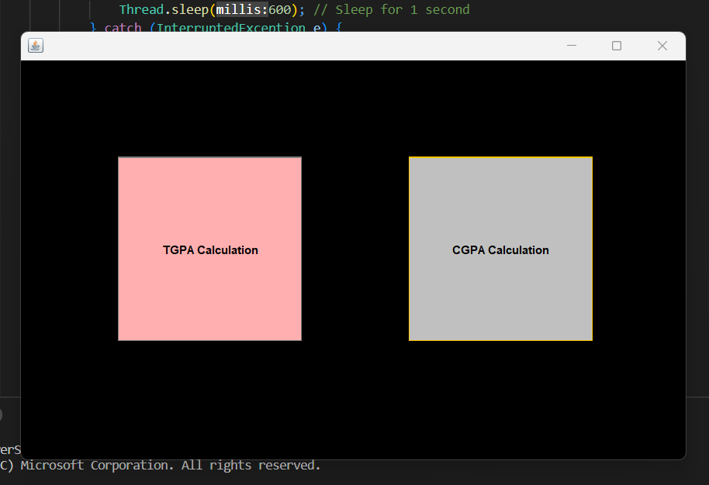
WELCOME MODULE
This is the welcome page of CGPA calculator
This module gives two options for the users
CGPA CALCULATION
TGPA CALCULATION
If user wants to calculate TGPA they have to select TGPA CALCULATOR
or
If user wants to calculate CGPA they have to select CGPA CALCULATOR

Slide 6
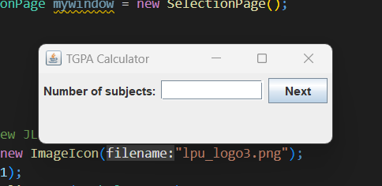
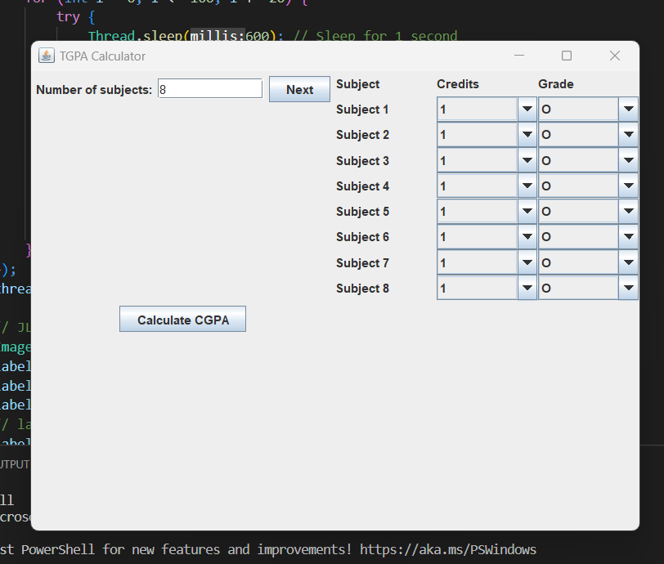
TGPA CALCULATOR
If User selects the TGPA calculator
It will ask the user to enter the number of subjects
After entering the number of subjects it will move to the next slide where user has to select the credits and grades for each subject
Then click on calculate button it shows the TGPA of the user.

Slide 7
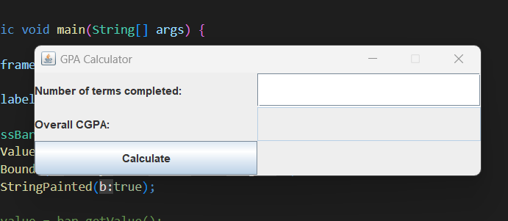
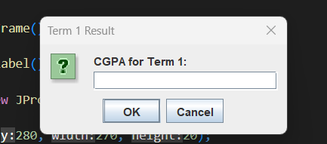
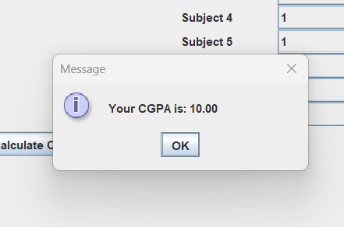
CGPA CALCULATOR
If User selects the CGPA calculator it will move on to the next page where user has to enter the number of terms they want to calculate the CGPA
After that they have to enter the TGPA of each term
Then it calculates and shows the overall CGPA of the user

Slide 8
CONCLUSION
In conclusion, CGPA (Cumulative Grade Point Average) and TGPA (Term Grade Point Average) calculators are important tools for students to track their academic progress, plan their academic path, and make informed decisions about their academic and career future.
CGPA calculator provides a snapshot of a student's overall academic performance by averaging the grade points earned in all the courses they have taken. It helps students to track their progress, stay motivated, and identify areas where they need to improve.
TGPA calculator, on the other hand, measures a student's academic performance in a particular term or semester by averaging the grade points earned in the courses taken during that term or semester. It helps students to monitor their academic performance on a short-term basis and make necessary adjustments to improve their grades.
Both CGPA and TGPA calculators take into account the grading system used by the institution or university, which assigns grade points to different letter grades. The calculators help students to accurately calculate their grades, which is useful for scholarship applications and other academic and career opportunities.
Overall, CGPA and TGPA calculators are essential tools for students to measure their academic performance, stay motivated, and make informed decisions about their academic and career future.

Slide 9


